Slide 1
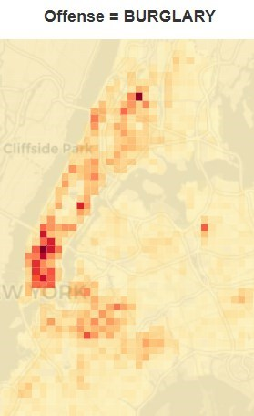
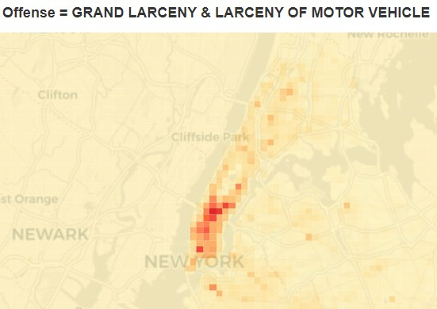
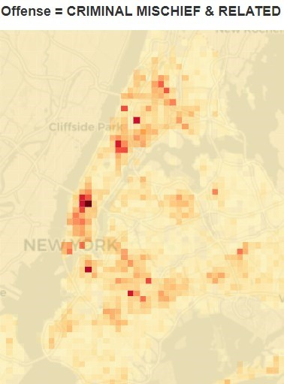
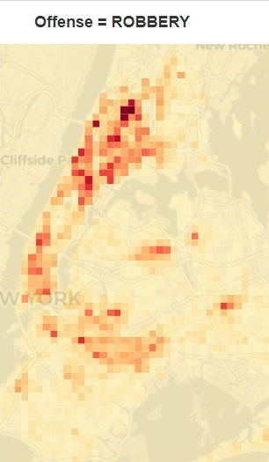
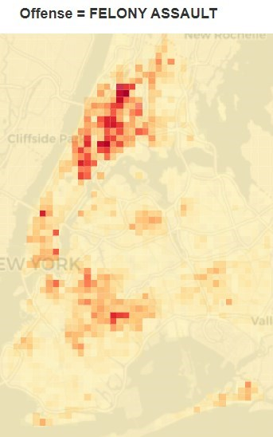
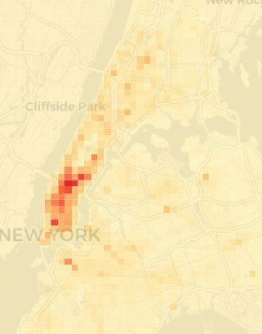
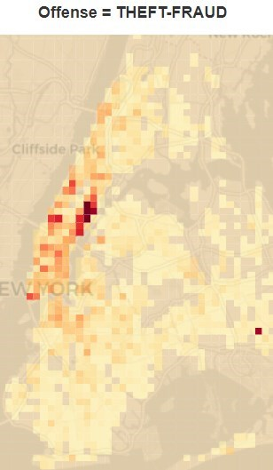
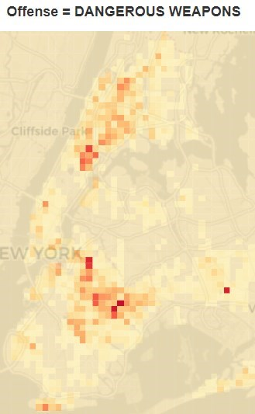
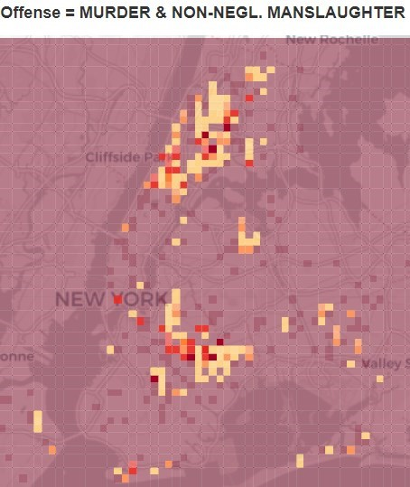
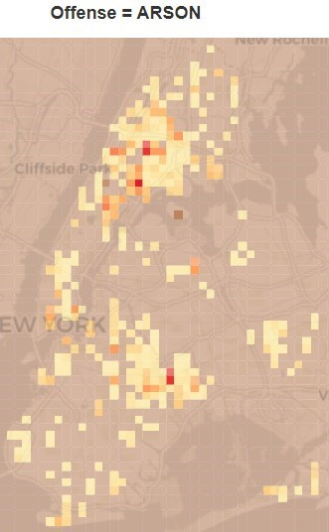
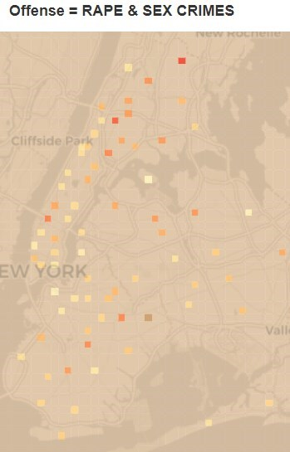

Slide 2
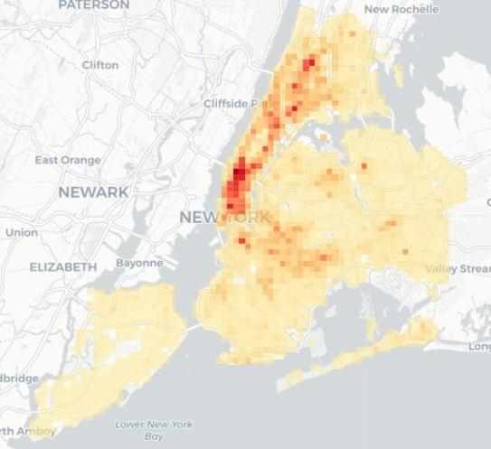
Fordham Heights & Mount Hope
3 Av - 149 St
Garment District
Soho District
Queens Crossing
Shepherd Avenue Station
Hoyt Street &
Atlantic Terminal

Slide 3
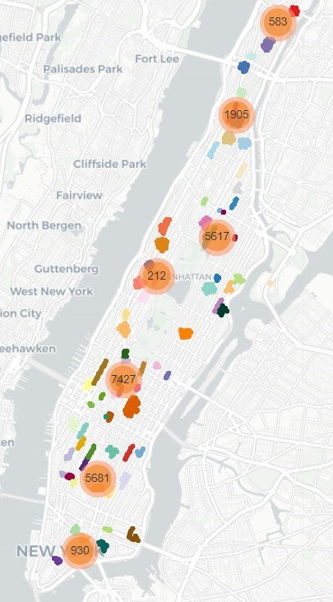
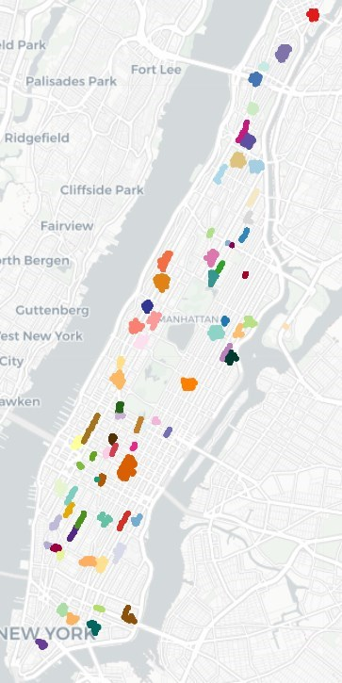

Slide 4
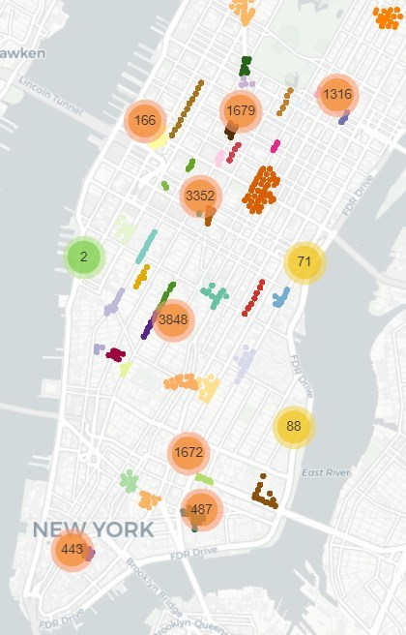
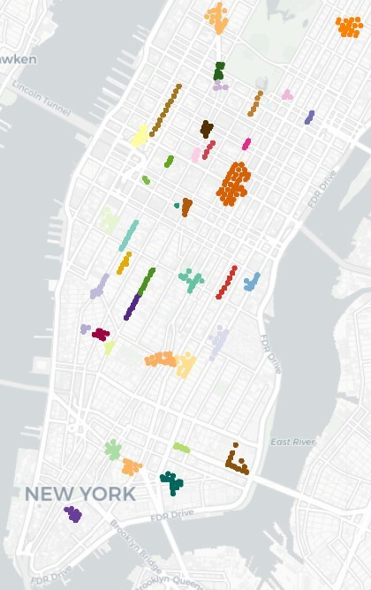
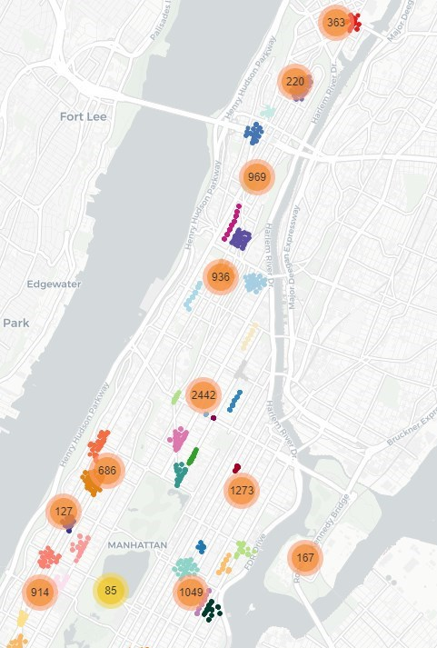
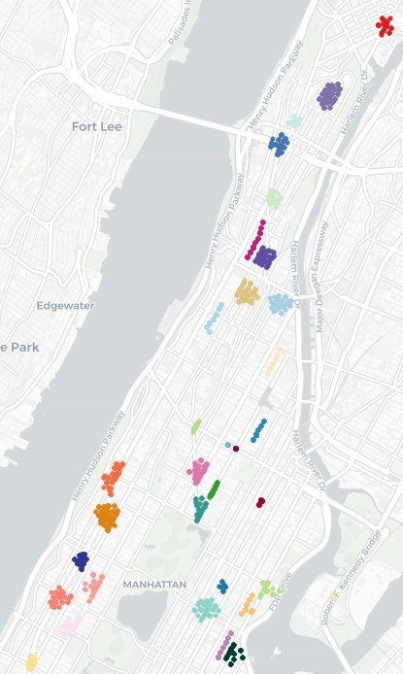
Street Train Yard
Lenox Hill Hospital
Grand Central Terminal
South Harlem
Manhattan Valley
Rockefeller Center
Madison Square Park
Mitchel Square
Lincoln Center
Street Train Yard
Lenox Hill Hospital
Columbus Circle
Marshall Store & Greyhound
LexingtonStores
Garment District/ Time Sqr.
Rockefeller Center
Mitchel Square
Grand Central Terminal
Greenwich Village
Madison Square Park
Manhattan Valley
Little Italy Walking St.
Baruch Playground
South Harlem
Fulton Walking St.
Orchard Walking St.
China Town Walking St.
Upper West Side

Slide 5
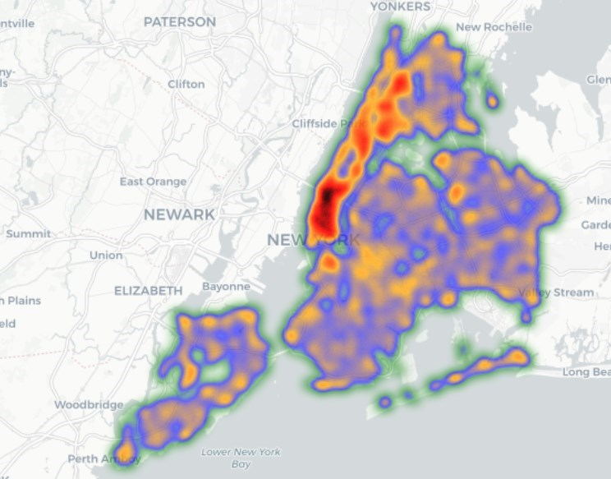
Upper Manhattan
Lower Manhattan
Queens Crossing
Brooklyn Bridge

Slide 6
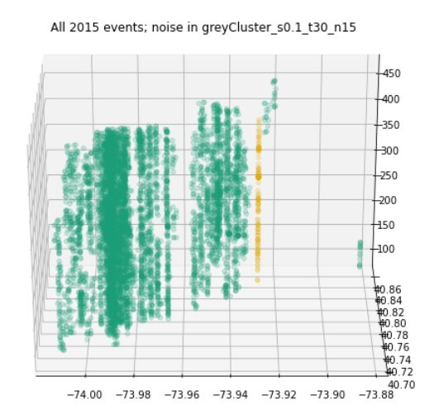
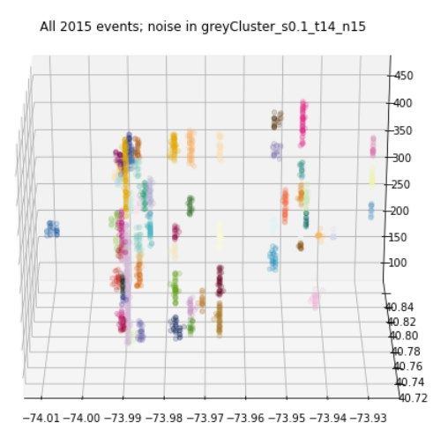
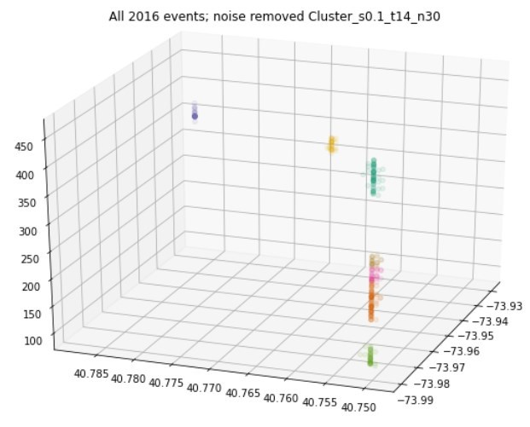
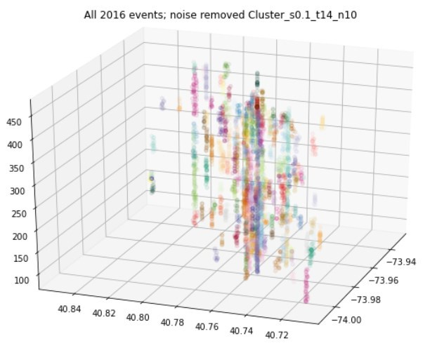
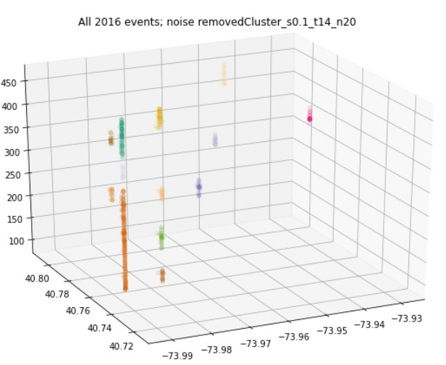
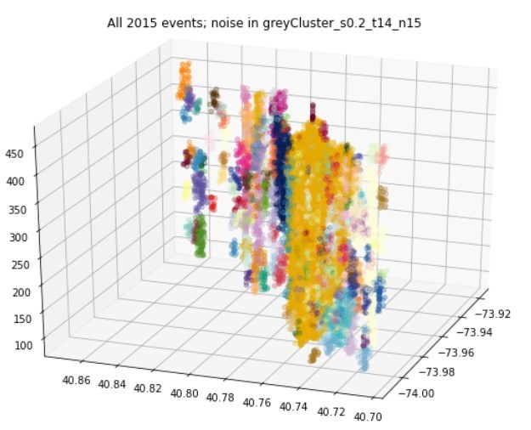
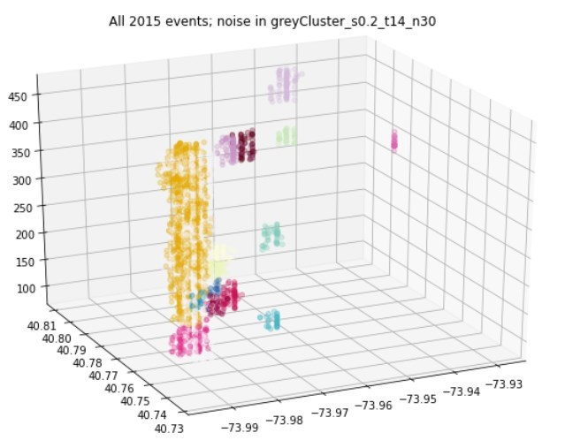
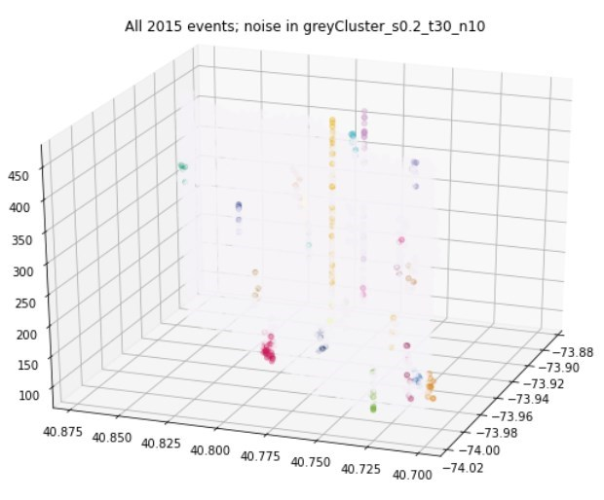
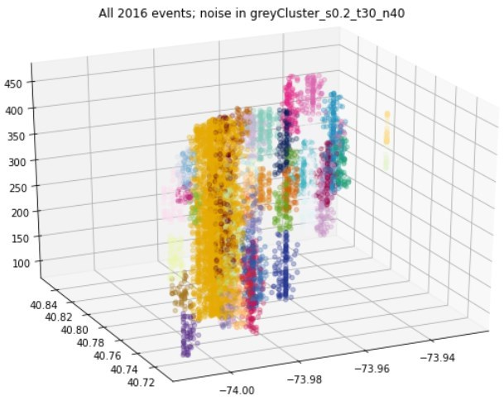
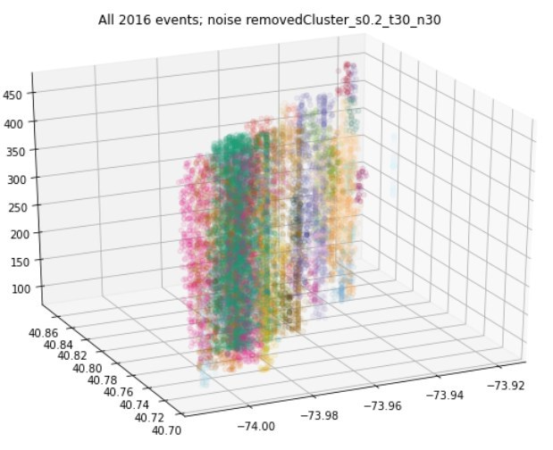
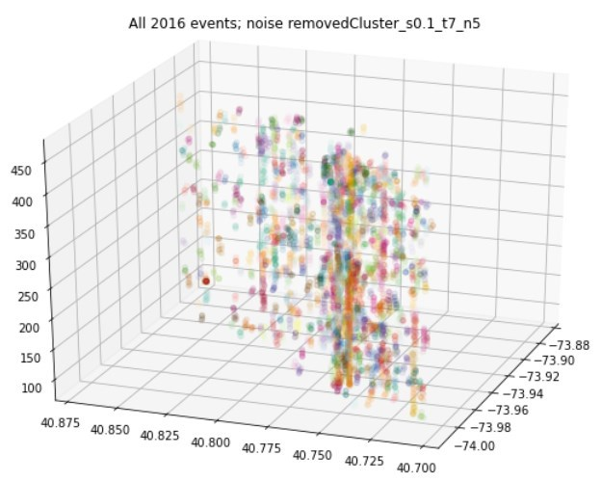
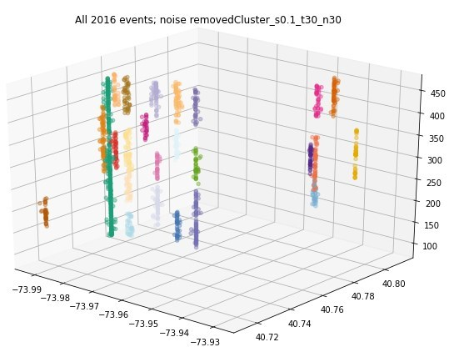
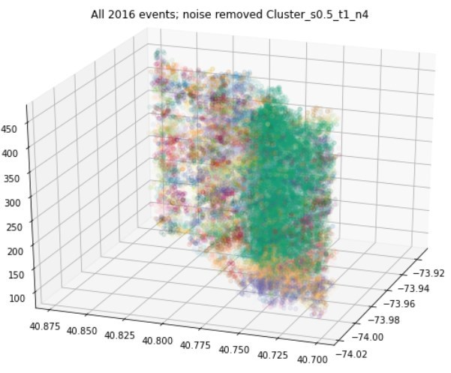

Slide 7
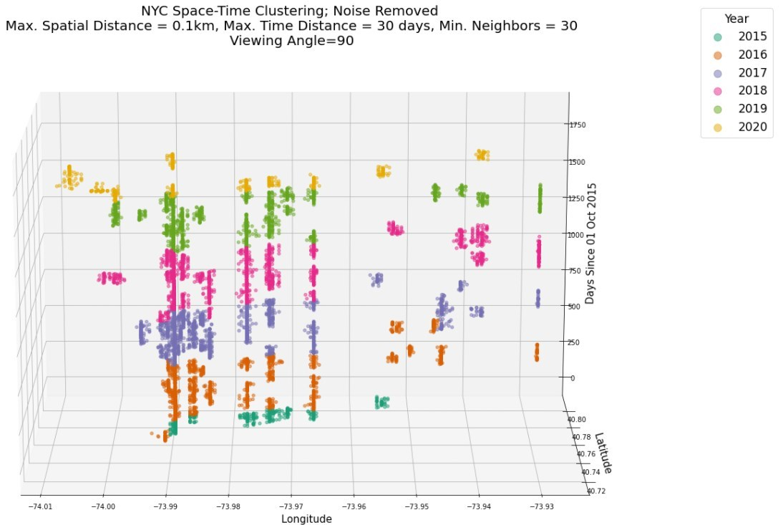

Slide 8
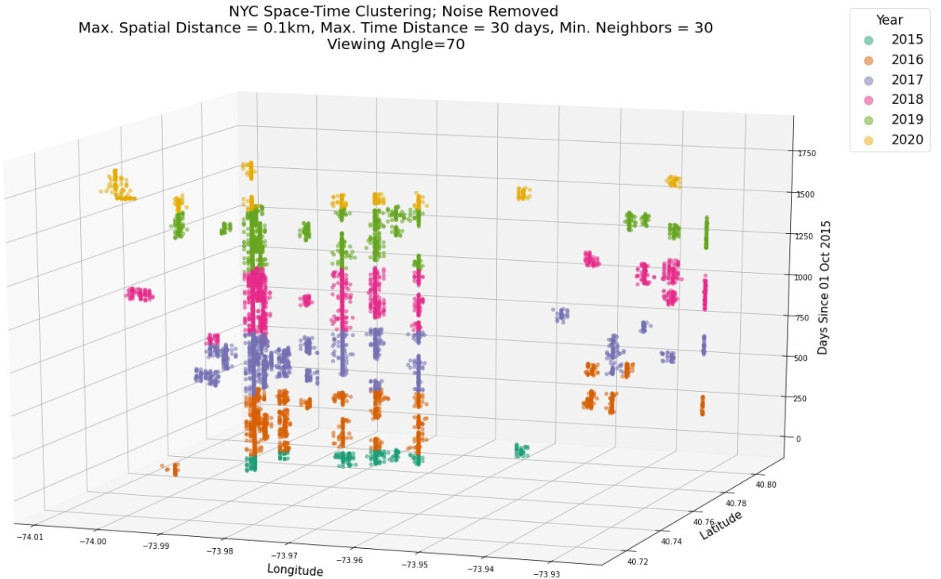
Central Park/ Pulitzer Fountain
Harlem 125th St Station
Greenwich/
Christopher St.
West 39th Street Ferry Terminal
Time Square
Rockefeller Center
Chelsea
Soho/ Prince St.
East/ Central Harlem
Randall’s Island Field
Lexington Stores
Upper West Side
China Town
Penn/ Pennsylvania Station
Columbus Circle/ SPYSCAPE

